Slide 1
Introduction to Electric and Electronics
Chapter 1 - Introduction

Slide 2
Learning Objectives
Learning Objectives
To understand the system of units and standard prefixes.
To review the fundamentals, e.g. charge, current, voltage and power.
To learn the definition and symbols.
To present Tellegen’s theorem.

Slide 3
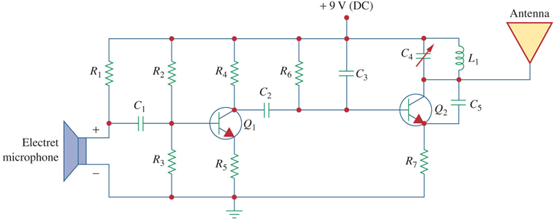
What is Circuit ?
What is a circuit?
An electric circuit is an interconnection of electrical elements.
It may consist of only two elements or many more:

Slide 4
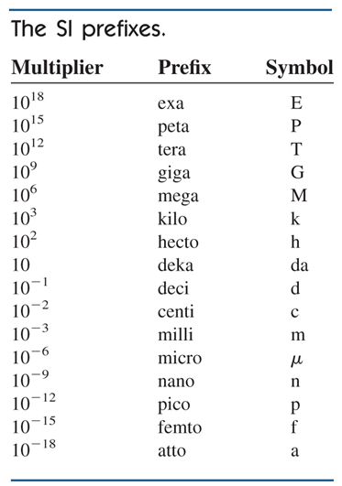
Units
Units
When taking measurements, we must use units to quantify values
We use the International Systems of Units (SI for short)
Prefixes on SI units allow for easy relationships between large and small values

Slide 5
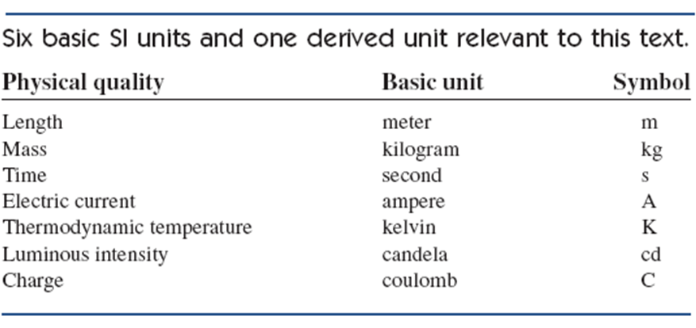
SI Units
SI Units

Slide 6
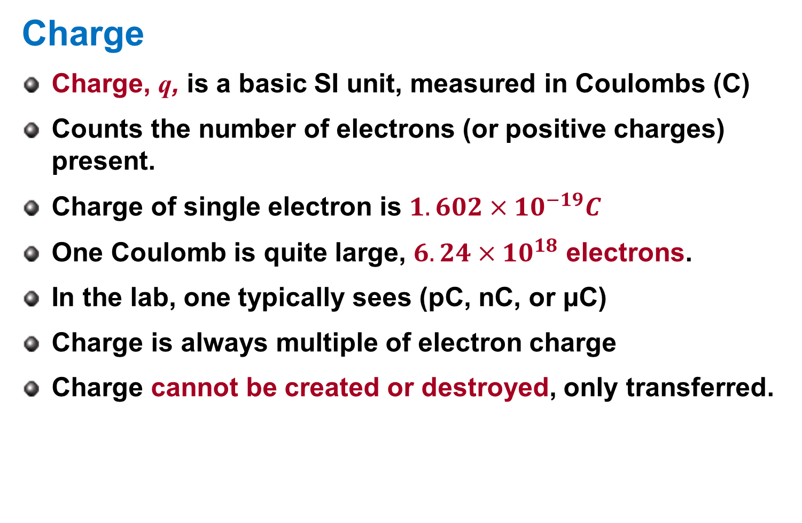
Charge
Charge
Charge, q, is a basic SI unit, measured in Coulombs (C)
Counts the number of electrons (or positive charges) present.
Charge of single electron is $1.602×{10}^{−19}C$
One Coulomb is quite large, $6.24×{10}^{18}$ electrons.
In the lab, one typically sees (pC, nC, or μC)
Charge is always multiple of electron charge
Charge cannot be created or destroyed, only transferred.

Slide 7
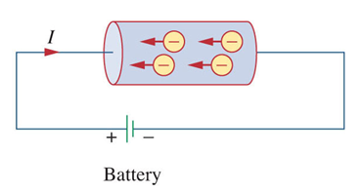
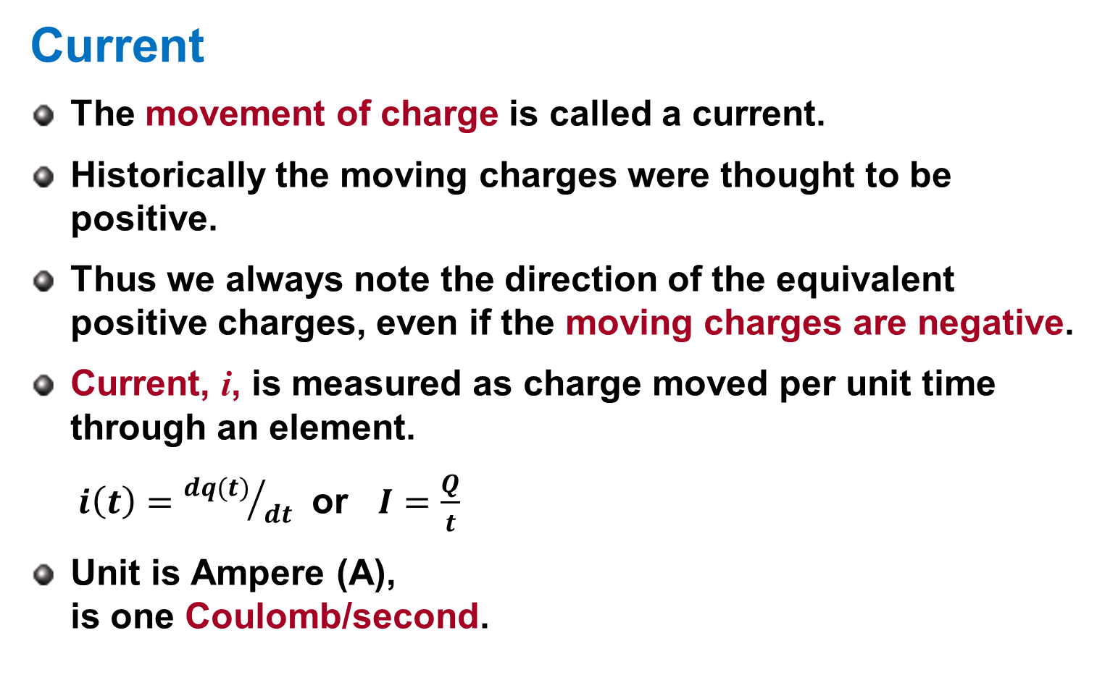
Current
Current
The movement of charge is called a current.
Historically the moving charges were thought to be positive.
Thus we always note the direction of the equivalent positive charges, even if the moving charges are negative.
Current, i, is measured as charge moved per unit time through an element.
$i\left(t\right)={dq(t)}/{dt}$ or $I=\frac{Q}{t}$
Unit is Ampere (A), is one Coulomb/second.

Slide 8
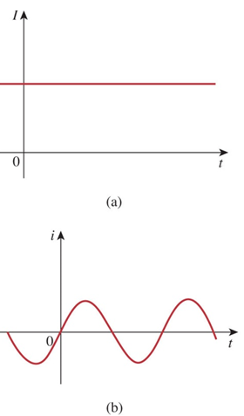
DC vs. AC
DC vs. AC
A current that remains constant with time is called Direct Current (DC).
Such current is represented by the capital I, time varying current uses the lowercase, i.
A common source of DC is a battery.
A current that varies sinusoidally with time is called Alternating Current (AC).
Mains power is an example of AC.

Slide 9
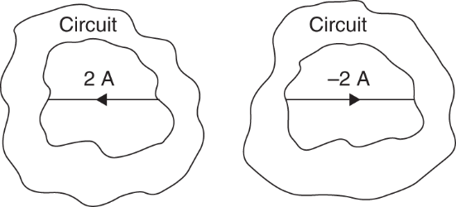
Direction of current
Direction of current
The sign of the current indicates the direction in which the charge is moving with reference to the direction of interest we define.
We need not use the direction that the charge moves in as our reference, and often have no choice in the matter.
A positive current through a component is the same as a negative current flowing in the opposite direction.

Slide 10
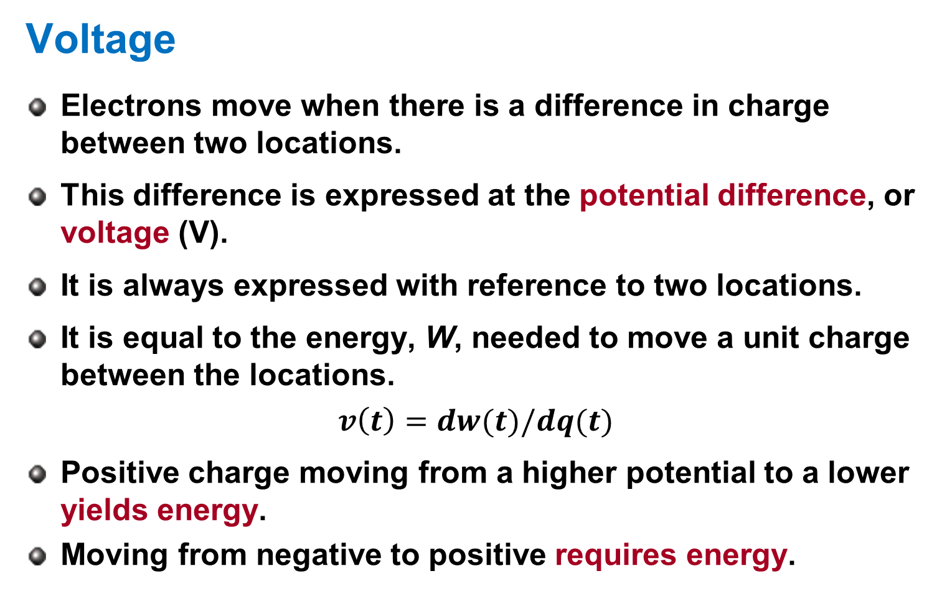
Voltage
Voltage
Electrons move when there is a difference in charge between two locations.
This difference is expressed at the potential difference, or voltage (V).
It is always expressed with reference to two locations.
It is equal to the energy, W, needed to move a unit charge between the locations.
$$v\left(t\right)=dw(t)/dq(t)$$
Positive charge moving from a higher potential to a lower yields energy.
Moving from negative to positive requires energy.

Slide 11
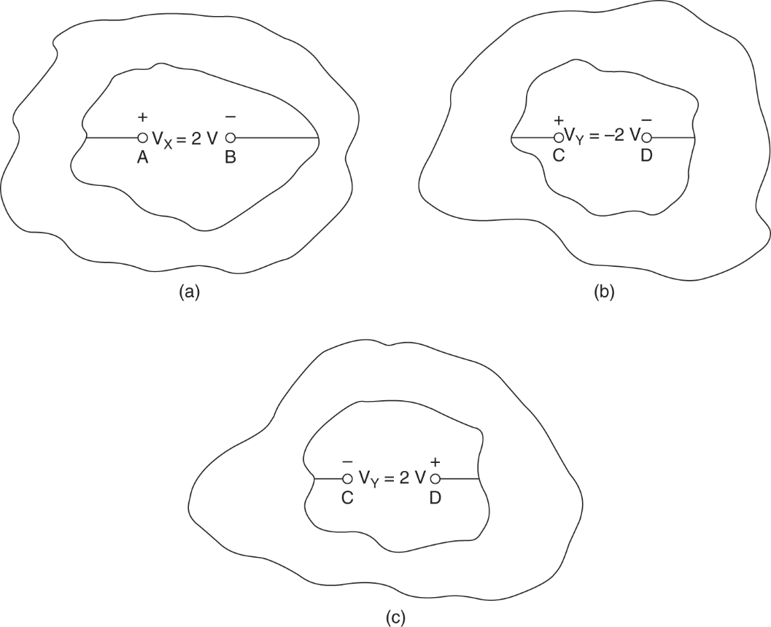
Voltage
Voltage description
Voltage is always expressed with reference to two locations.
We need to know which point is at the higher potential.

Slide 12
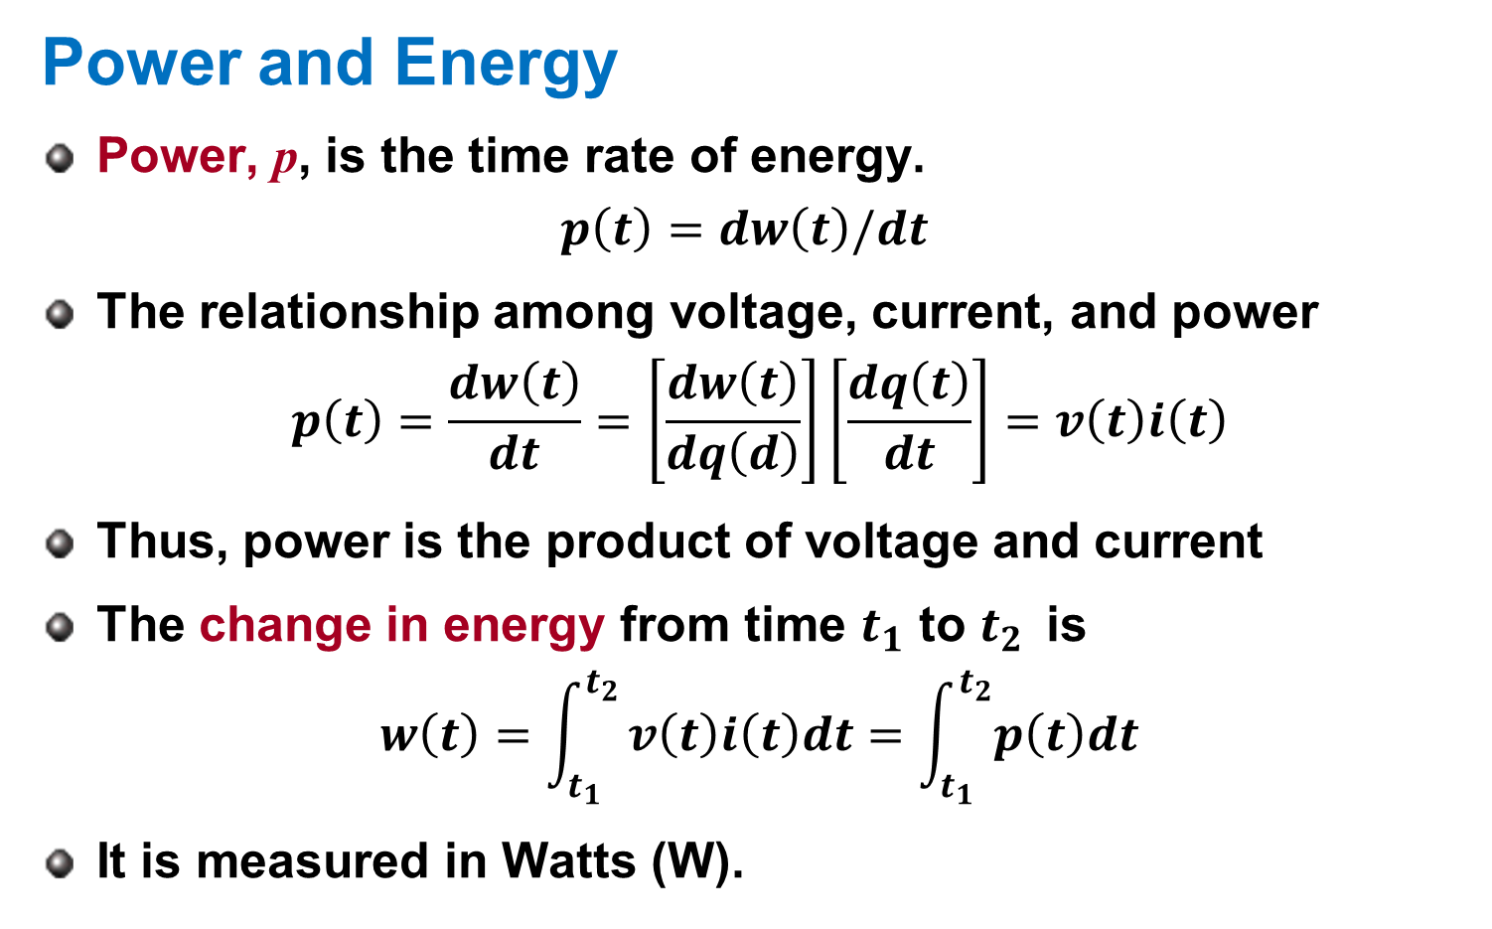
Power and Energy
Power and Energy
Power, p, is the time rate of energy.
$$p\left(t\right)=dw\left(t\right)/dt$$
The relationship among voltage, current, and power
$$p\left(t\right)=\frac{dw\left(t\right)}{dt}=\left[\frac{dw\left(t\right)}{dq\left(d\right)}\right]\left[\frac{dq\left(t\right)}{dt}\right]=v\left(t\right)i\left(t\right)$$
Thus, power is the product of voltage and current
The change in energy from time $t_{1}$ to $t_{2 }$ is
$$w\left(t\right)=\int_{t_{1}}^{t_{2}}{v\left(t\right)i\left(t\right)dt=\int_{t_{1}}^{t_{2}}{p\left(t\right)dt}}$$
It is measured in Watts (W).

Slide 13
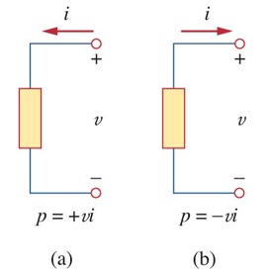
Passive Sign Convention
Passive Sign Convention
By convention, we say that an element being absorbed power has positive power.
A power source, such as a battery has negative power.
Passive sign convention is satisfied if the direction of current is selected such that current enters through the terminal that is more positively biased.

Slide 14
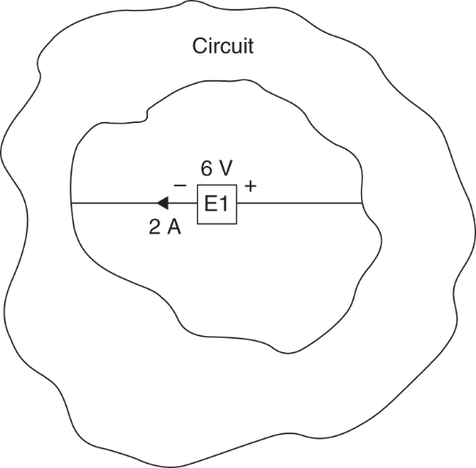
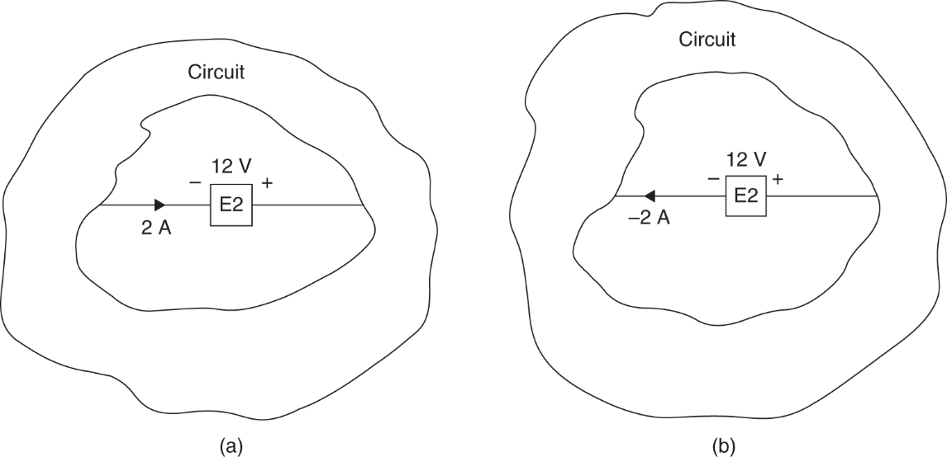
Example 1.1
Example 1.1
Let us determine if the elements E₁ and E₂ in Fig.1.5 and 1.6, respectively, are absorbing or supplying power and how much.
Fig. 1.5 Fig. 1.6

Slide 15
Circuit Elements
Circuit Elements
Two types:
Active
Passive
Active elements can generate energy
Generators
Batteries
Operational Amplifiers

Slide 16
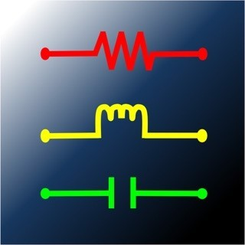
Circuit Elements
Circuit Elements II
Passives absorb energy
Resistors
Inductors
Capacitors
But it should be noted that only the resistor dissipates energy ideally.
The inductor and capacitor do not.

Slide 17
Sources
Sources
Ideal and nonideal
Sources
Voltage source
Current source
Types:
Independent
Dependent

Slide 18
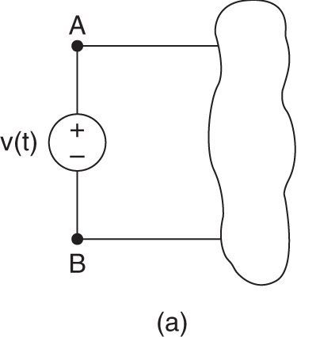
Ideal Voltage Source
Ideal Voltage Source
An ideal voltage source has no internal resistance.
It also is capable of producing any amount of current needed to establish the desired voltage at its terminals.
Thus we can know the voltage at its terminals, but we don’t know in advance the current.

Slide 19
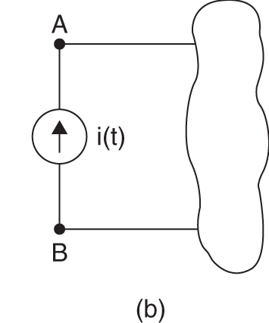
Ideal Current Source
Ideal Current Source
Current sources are the opposite of the voltage source:
They have infinite resistance
They will generate any voltage to establish the desired current through them.
We can know the current through them in advance, but not the voltage.

Slide 20
Ideal Source
Ideal Source
Both the voltage and current source ideally can generate infinite power.
They are also capable of absorbing power from the circuit.
It is important to remember that these sources do have limits in reality:
Voltage sources have an upper current limit.
Current sources have an upper voltage limit.

Slide 21
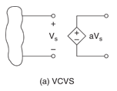
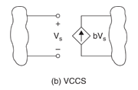
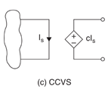
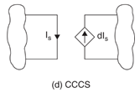
Dependent Source
Dependent Source
A dependent source has its output controlled by an input value.
Symbolically represented as a diamond
Four types:
A voltage-controlled voltage source (VCVS).
A voltage-controlled current source (VCCS).
A current-controlled voltage source (CCVS).
A current-controlled current source (CCCS).

Slide 22
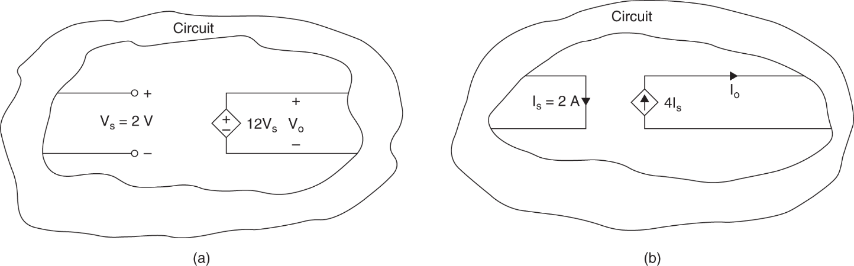
Example 1.3
Example 1.3
Let us determine the outputs of each source
Fig. 1.10

Slide 23
Tellegen’s Theorem
Tellegen’s Theorem
Conservation of energy
In a circuit, energy cannot be created or destroyed.
Thus power also must be conserved.
The sum of all power supplied must be absorbed by the other elements.
Energy can be transformed from one form to another

Slide 24
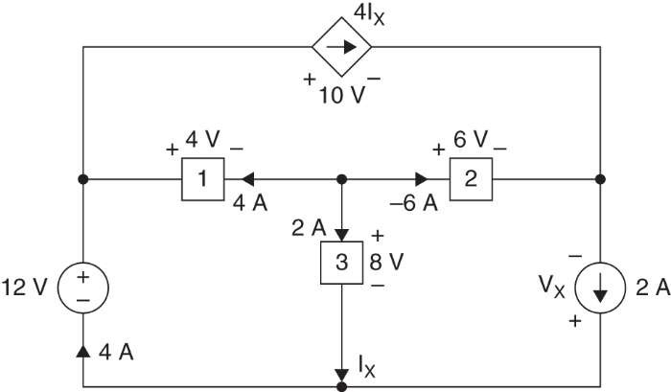
Example 1.4
Example 1.4
Let us determine V_{X}
Fig. 1.11

Slide 25
Problem Solving
Problem Solving
Successfully solving an engineering problem requires a process.
Shown here is an effective method for determining the solution any problem.
1. Carefully define the problem.
2. Present everything you know about the problem.
3. Establish a set of alternative solutions and determine the one that promises the greatest likelihood of success.
4. Attempt a problem solution.
5. Evaluate the solution and check for accuracy.
6. Has the problem been solved satisfactorily? If so, present the solution; if not, then return to step 3 and continue through the process again.

Slide 26
Problem Solving II
Problem Solving II
Carefully define the problem
This is the most important step
What needs to be solved?
What questions need to be addressed before solving? Find the sources to answer them.
Present everything you know about the problem
What do you know?
What don’t you?

Slide 27
Problem Solving III
Problem Solving III
Establish a set of alternative solutions and determine the one that promises the greatest likelihood of success.
Most problems have more than one way to be solved
But not all solutions are as simple
Are the required tools available?

Slide 28
Problem Solving IV
Problem Solving IV
Attempt to solve the problem
Documenting this process is very important
Evaluate the solution and check for accuracy
Does it makes sense?
Is it consistent with any assumptions made?
Is the solution satisfactory? If not, try an alternate solution.

Slide 29
Homework
Homework
Read Text Chapter 2.
Prepare Presentation

